Slide 1
Portfolio optimization
Final project – numerical optimization with Python
Alon Mannor
Ady Michelson
All code and plots can be found at:
https://github.com/Amannor/python_numerical_optimizations/tree/main/final_project
Notes:
Alon starts talking here

Slide 2
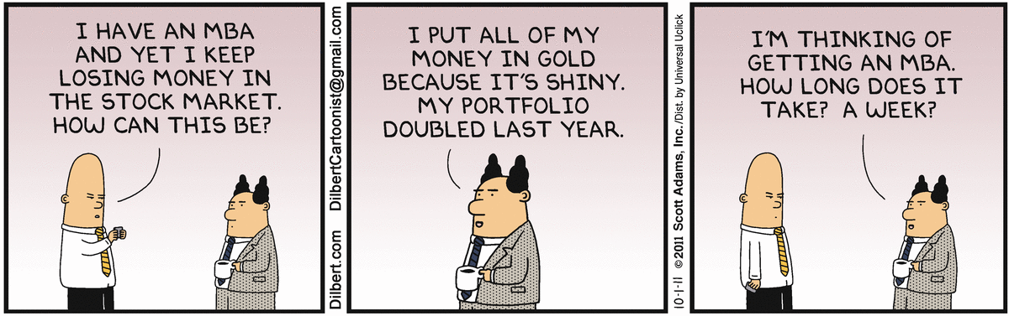
Portfolio optimization

Slide 3
Portfolio optimization - agenda
Domain problem background and motivation
Markowitz model essentials
Data overview

Slide 4
Portfolio optimization - agenda
Model the problem
Optimization algorithm
Results and conclusions (efficient frontier)
Final (real world) notes

Slide 5
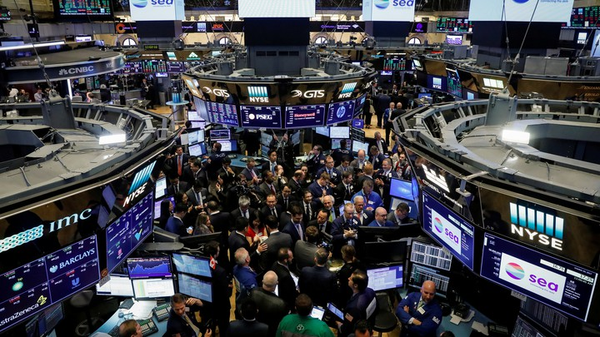
Portfolio optimization – motivation
Notes:
A question to the audience: ”By show of hands – who here is invested in the stock market?” Tell them that every person that has ever received a paycheck (in Israel at least) in invested in the stock market through his\hers pension plan. Everyone in here today is one of 2 things (or both):
Managing their money in the stock exchange
Having someone else managing it for them
Question: “What is a stock exchange and is being done there?”
A: A stock exchange is a market where people can buy and sell financial assets. We’ll focus on one specific kind: small pieces of a company (a.k.a “stocks”).
Each stock is a legally binding piece of data that states that the person who owns it – owns a small part of that company (e.g. a single stock of Microsoft).
Stock price is decided by supply and demand: the more people want to buy it – it goes up. The more people want to sell it – it goes down.
This lecture will NOT be about stuff like payslips, pension, insurance or anything like – but rather will attempt to be a small glimpse “behind the scenes” of what goes through the mind of the people managing our funds and as a result control such a huge power of our future life (e.g. in our retirement funds).

Slide 6
Portfolio optimization – The problem
How to maximize profit while minimizing risk?
Notes:
We don’t want to buy stocks that’ll go down and we do want to buy stocks that’ll go up.
Given that we can’t know the future – what can we do?

Slide 7
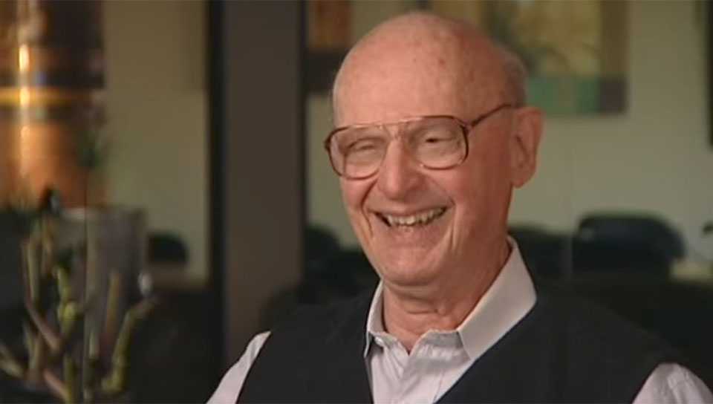
Portfolio optimization – The solution
https://en.wikipedia.org/wiki/Modern_portfolio_theory https://en.wikipedia.org/wiki/Markowitz_model
Notes:
“Anybody recognizes this guy?”
This is Harry Markowitz, the “father” of modern portfolio theory. He created a mathematical model (named the Markowitz model) to answer exactly that question (how to maximize return while minimizing risk). This model, along with his other work, contributed to him receiving the Nobel prize for economics in 1990).
In short (and with some frivolous hand waving) the model lays out a mathematical approach for choosing the best (read: has the highest expected return) investment portfolio, given the investor’s maximum tolerated risk.
For example, one can think of the risk in terms of percentage of the portfolio lost. If I have 100$ invested – will I be willing to risk a 1% loss? 10%? Perhaps 90%?
***Important*** points to take from his model:
The higher the risk tolerance – the higher the expected return
Diversification is key – don’t put all your eggs in one basket – since you’ll never know what might happen
There’s no point in taking assets that historically are very highly correlated (since there’s an added overhead in buygin more and more assests, e.g. managing costs, minimum amount of stocks allowed to buy etc.).
2) + 3) together can be summarized: “We want to take several different assets”

Slide 8
portfolio optimization – The (big?) question
What is risk?
What is return?
How do you model them
Notes:
There are several acceptable ways of defining risk and return.
The way we chose (which is the “canonical” way, per the Markowitz model) is:
- Risk: The variance of the stock. This can thought of how “jumpy” the stock graph is – the more “jumpy” – the riskier the stock
- Return: Average yearly return. For example let’s say that at the start of the year I invest 100$. By the end of the 1st year I have made 20% - so I have 120$ at the start of the second year. In the second year I’ve only made 1% (i.e. I have 121$ by the end of the second year). The average yearly return is (10+1)/2 = 5.5%
Maybe mention:
There are as I said more ways to model risk and return:
Risk: one can look at the variance – but only “count” to the risk only “down” jumps (i.e. every times the stock price decreased).
Beta (taking a certain leading index and considering it a “baseline” to which we compare all the stocks behavior). This is usually done with things called “index funds” that we won’t go into at the moment.
Return: One can look at the dividends the stock gave to the investors (i.e. a certain percent of the profit the company made that year), once can look at a yield per quarter, not per year and so on.

Slide 9
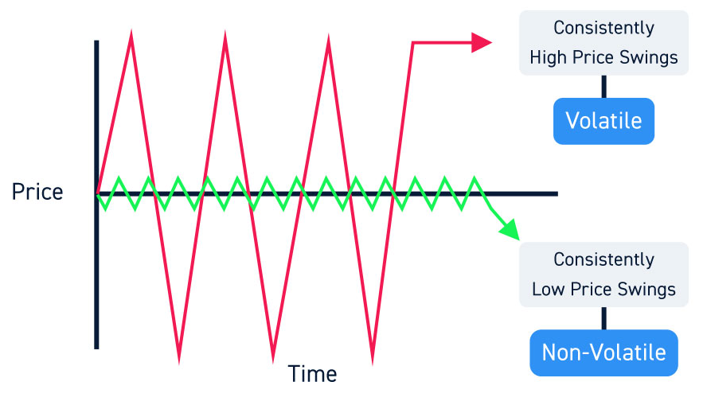
portfolio optimization – The (big?) question
Source: https://centerpointsecurities.com/liquidity-volatility-day-trading/
Notes:
Here we see that the red stock has a very high variance (in our case high risk).
The green stock has a very high variance (in our case low risk)

Slide 10
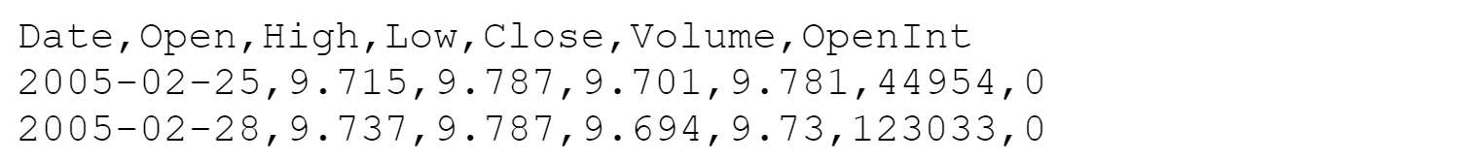
The data
Filtering:
From domain world: volume, minimal price, trading time
We chose 128 assets from 2012-2016
Source: https://www.kaggle.com/borismarjanovic/price-volume-data-for-all-us-stocks-etfs

Slide 11
The data
Open – the price of the stock in the begging of the trading day
Close – the price of the stock in the end of the trading day
High – the highest price of the stock in the current day
low – the lowest price of the stock in the current day
Volume – the number of times that the stock was traded in the current day
Notes:
Ady starts talking here (Alon stops)

Slide 12
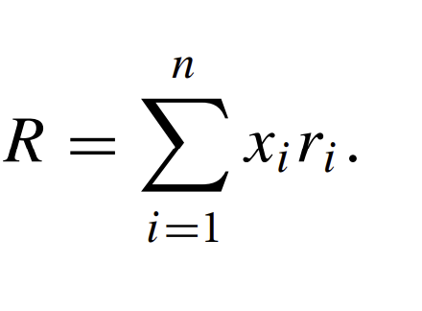
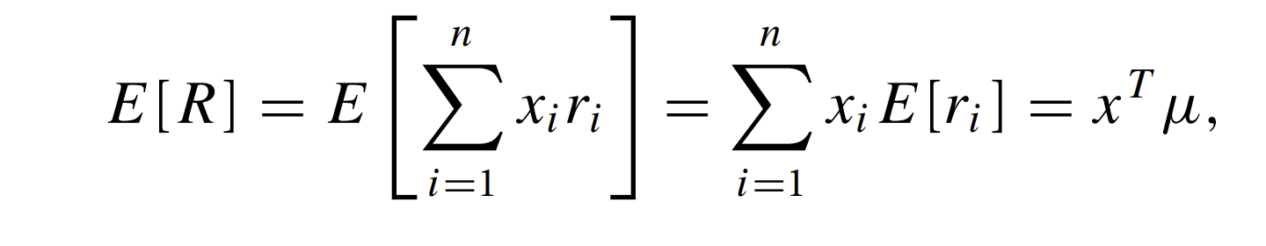
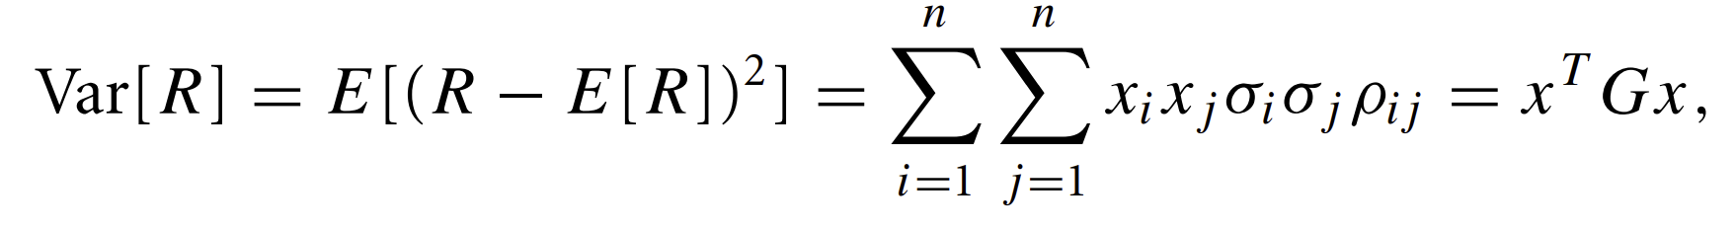
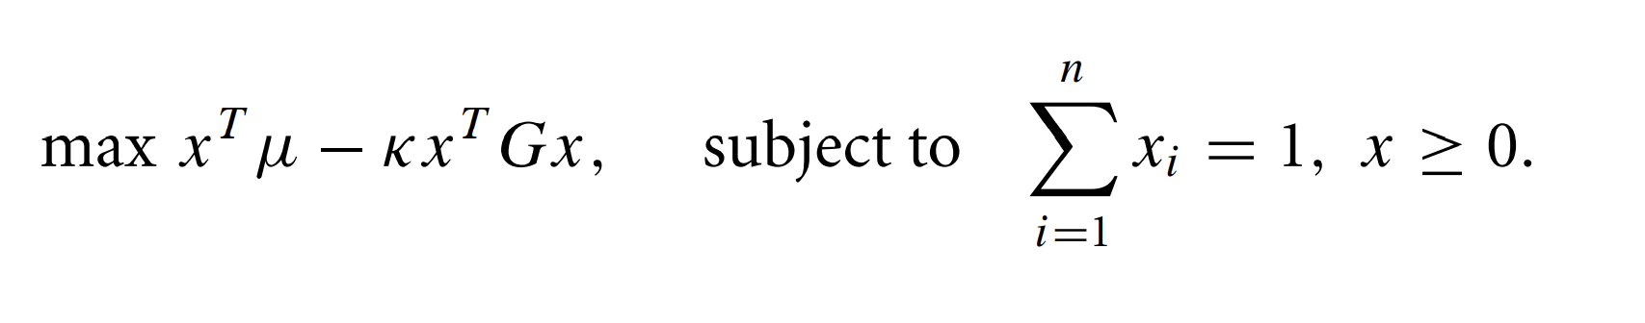
Model the problem
Portfolio theory studies how to model this tradeoff given a collection of n possible investments with returns ri , i 1, 2,..., n.
κ is the risk tolerance
Notes:
Alon starts talking here (Ady stops)
The Greek letter Kappa represents the “risk coefficient”

Slide 13
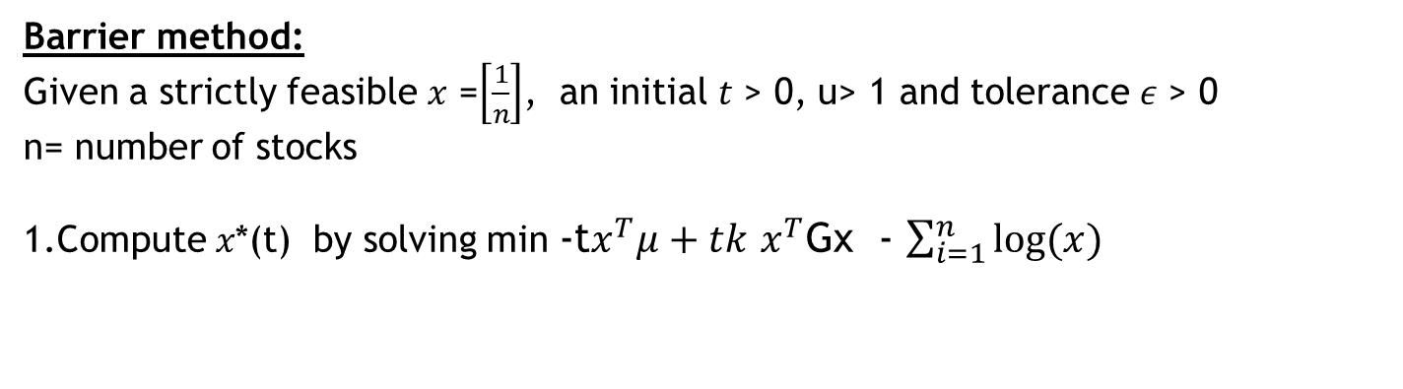
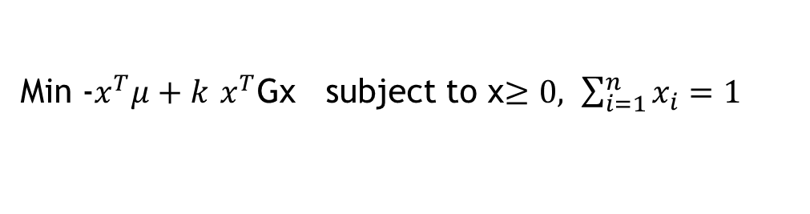
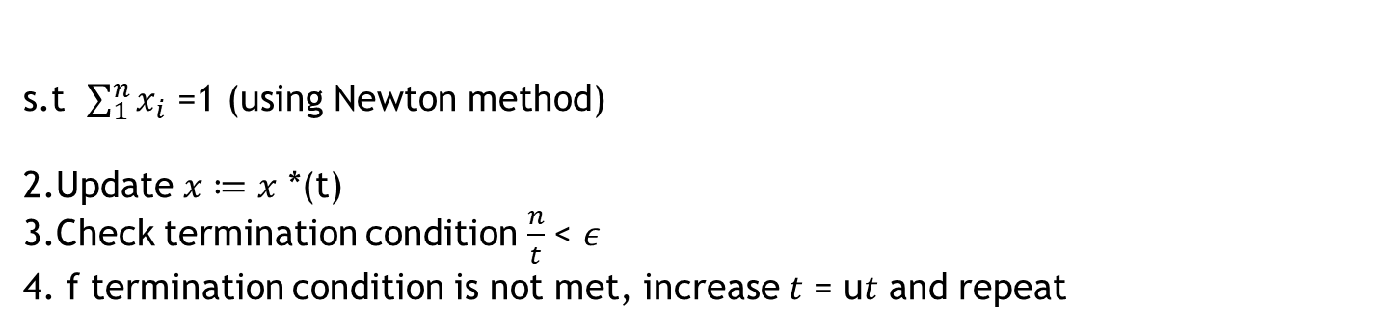
The optimization algorithm
Min -$x^{T}μ+k$ $x^{T}$Gx subject to x$≥0, \sum_{i=1}^{n}{x_{i}=1}$
Barrier method:
Given a strictly feasible 𝑥 =$\left[\frac{1}{n}\right]$, an initial 𝑡 > 0, u> 1 and tolerance 𝜖 > 0
n= number of stocks
1.Compute 𝑥*(t) by solving min -t$x^{T}μ+tk$ $x^{T}$Gx - $\sum_{i=1}^{n}{log⁡(x)}$
s.t $\sum_{1}^{n}{x_{i}}$ =1 (using Newton method)
2.Update 𝑥 ≔ 𝑥 *(t)
3.Check termination condition $\frac{n}{t}$< 𝜖
4. f termination condition is not met, increase 𝑡 = u𝑡 and repeat
Notes:
Ady starts talking here (Alon stops)

Slide 14
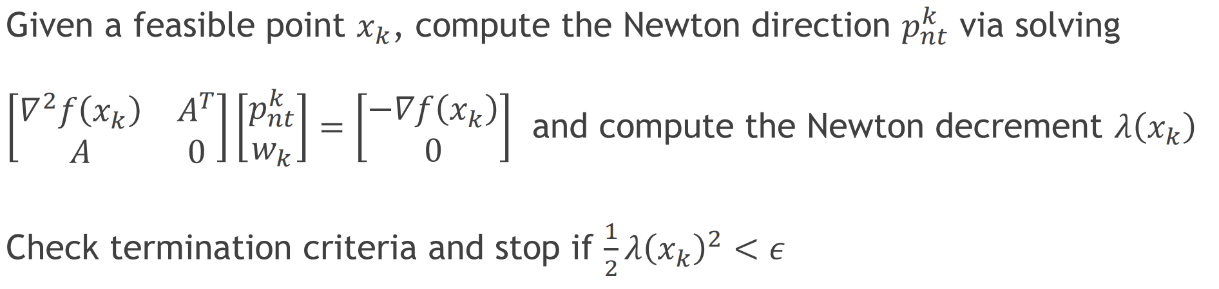
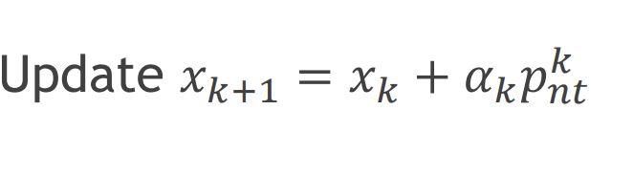
The optimization algorithm
Newton method:

Slide 15
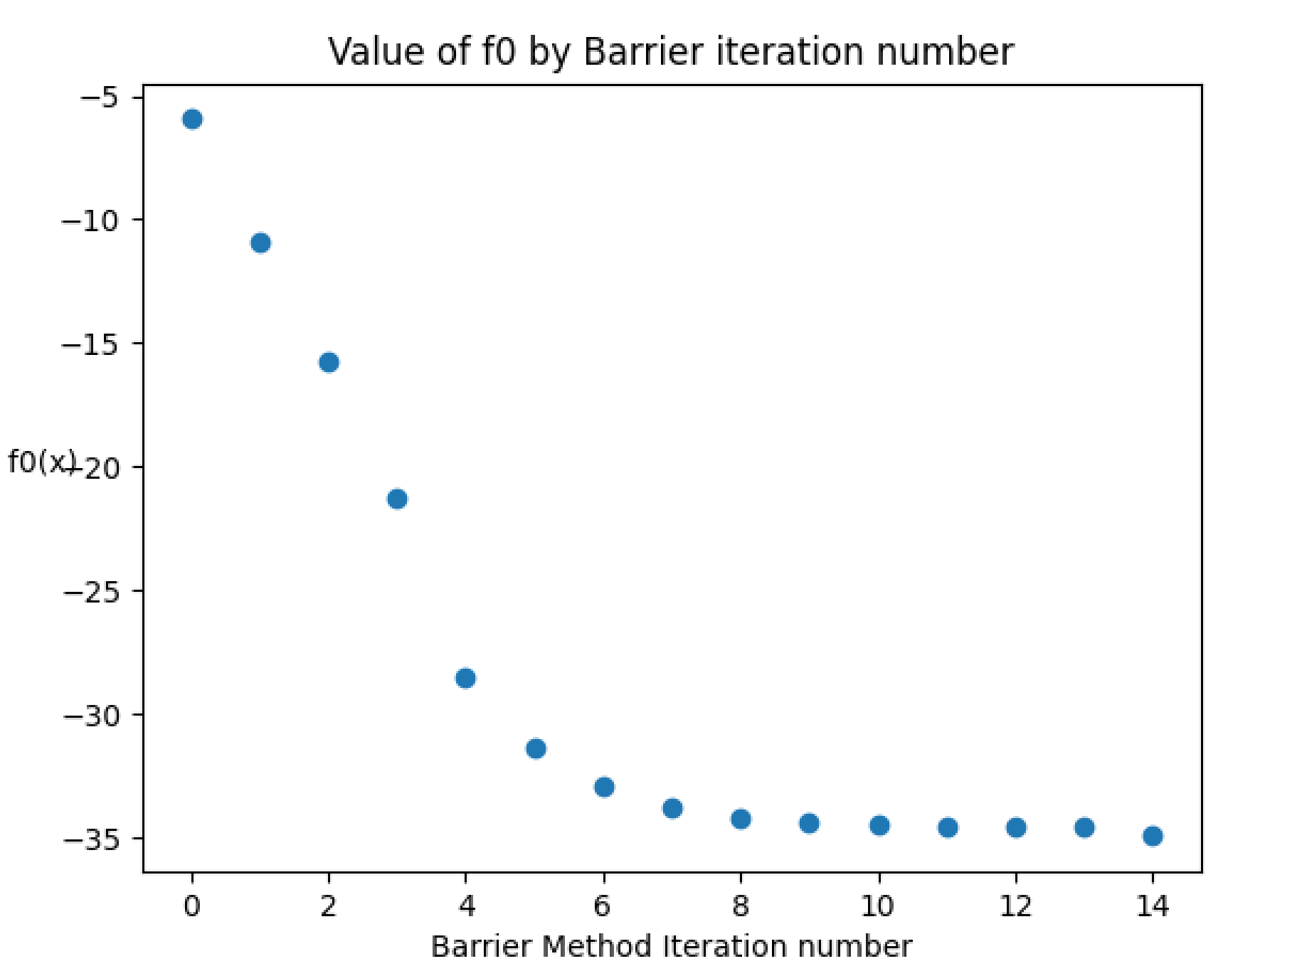
The optimization algorithm

Slide 16
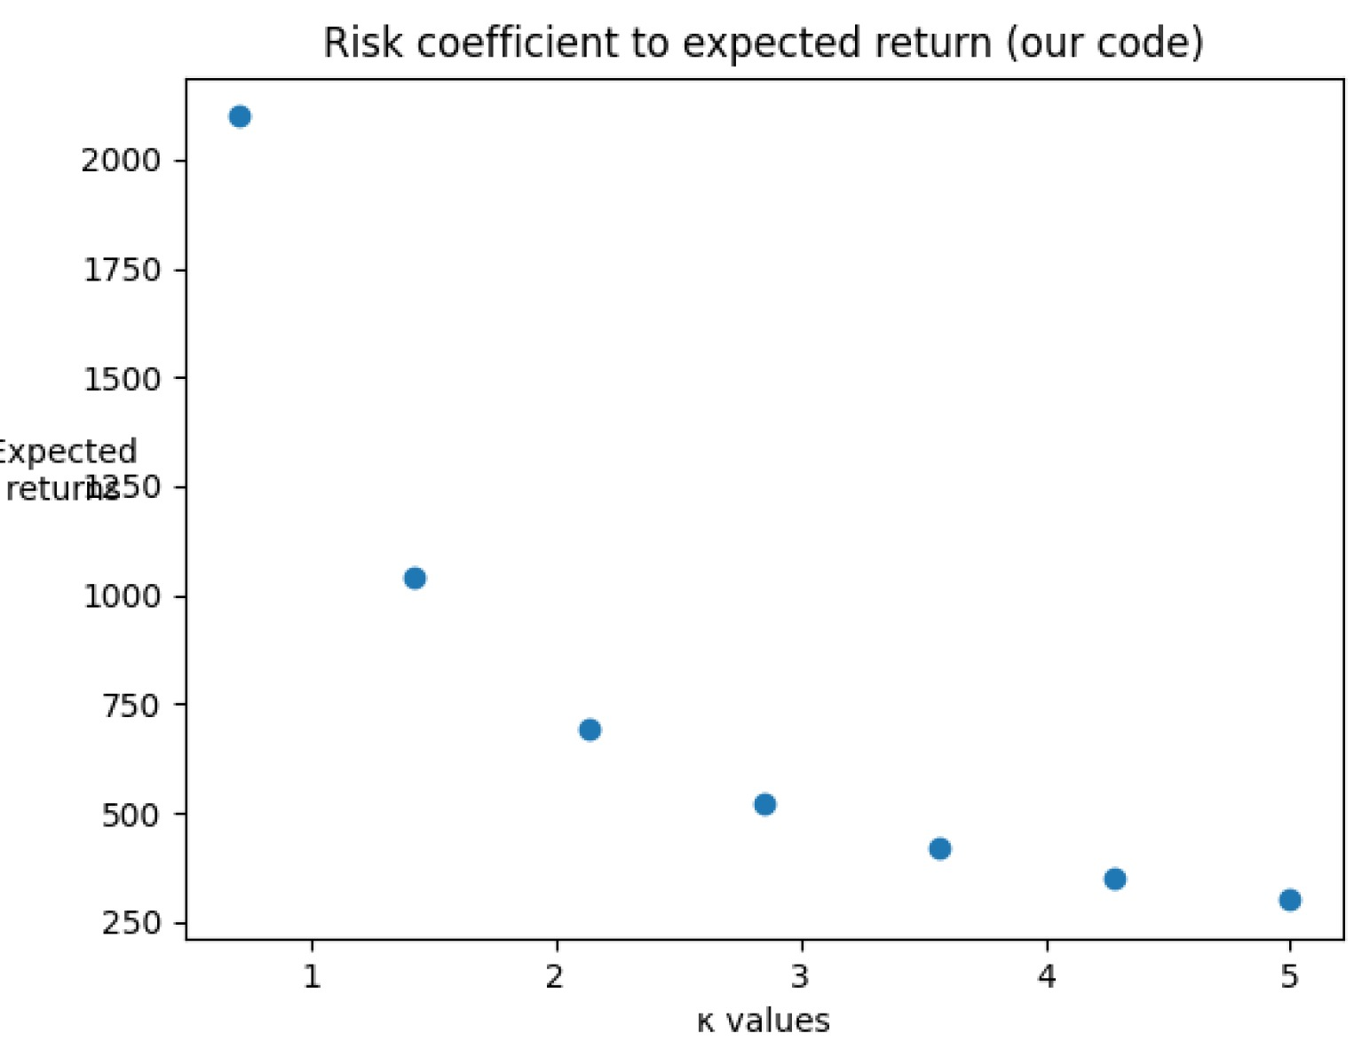
The optimization algorithm

Slide 17
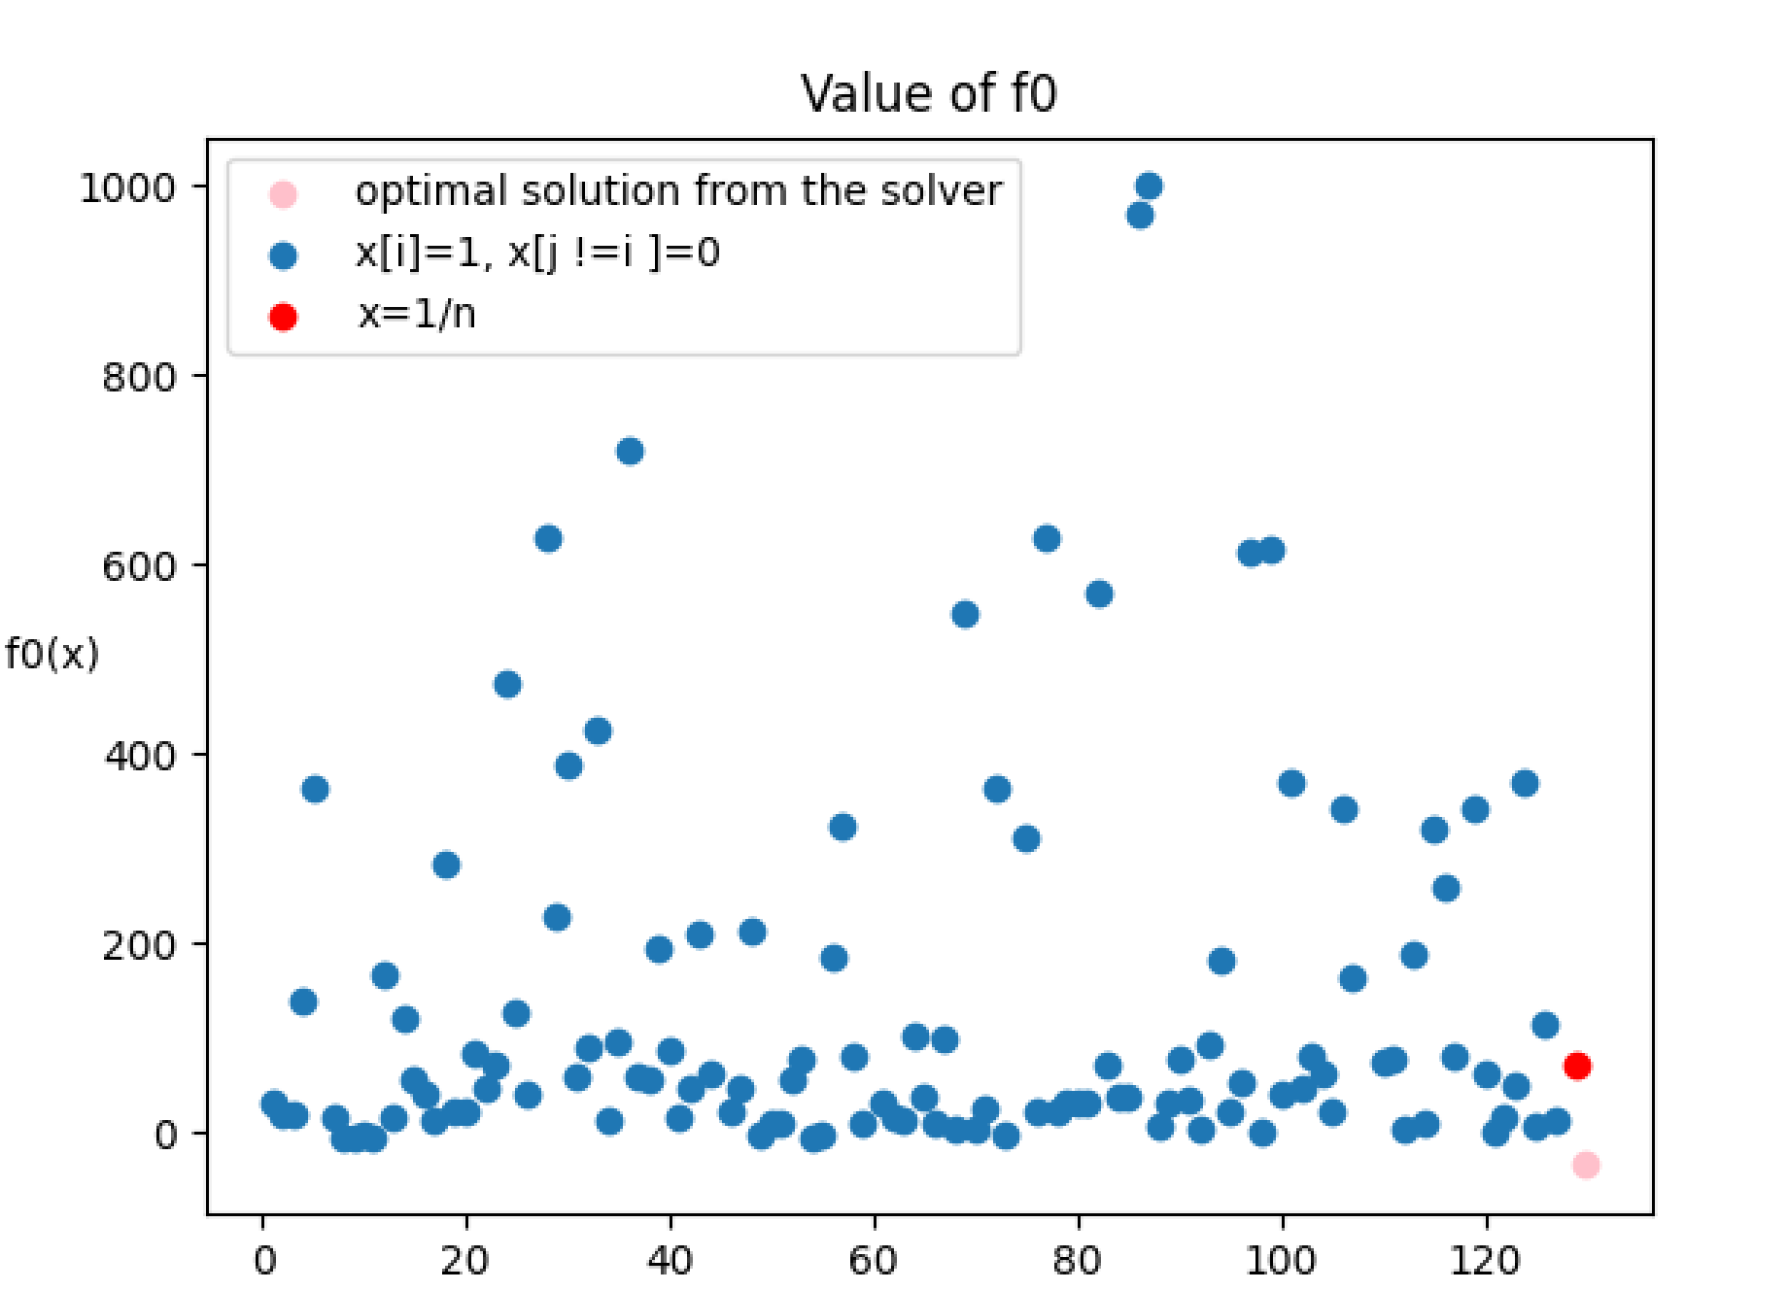
The optimization algorithm

Slide 18
portfolio optimization
By Alon Mannor and Ady Michelson

Slide 19
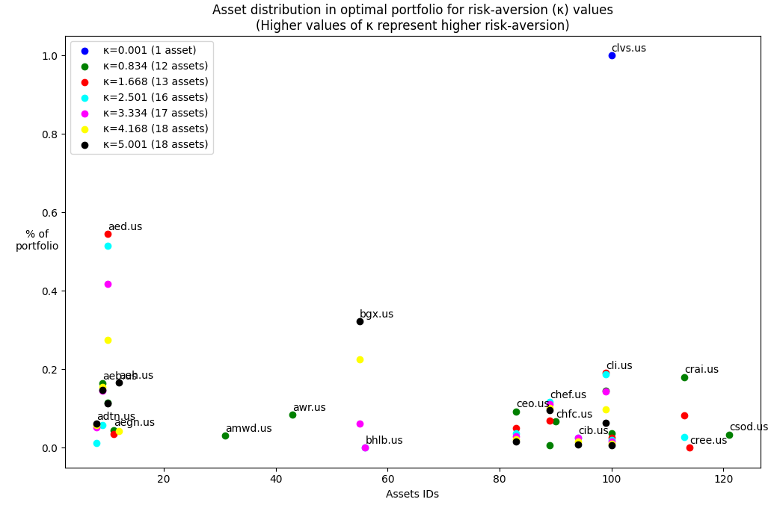
Results and conclusions
Notes:
Alon starts talking here (Ady stops)
The points they represent assets distribution per risk level. The points themselves don’t matter so much. The interesting thing to see here is the more risk tolerant we are – the less assets we have in the portfolio (we’re less “afraid” of the putting our eggs in one basket)

Slide 20
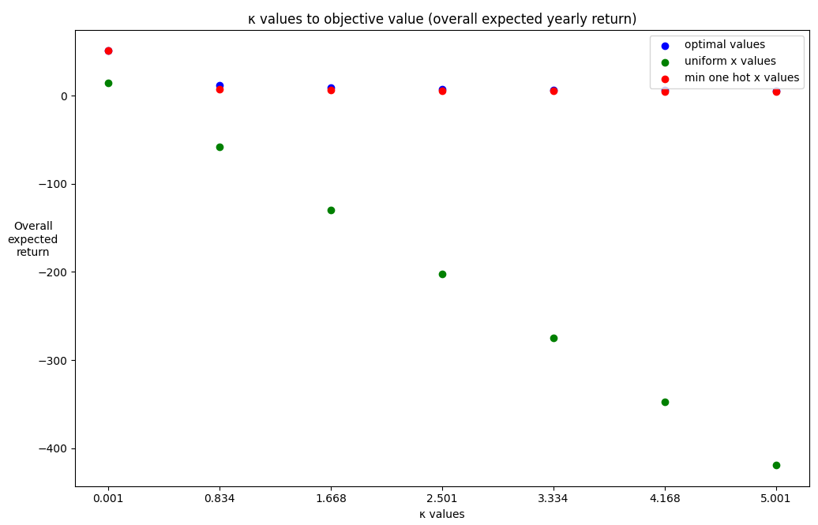
Results and conclusions
Notes:
This is a very very insightful graph for real life investing techniques and know-how. Theoretically it says that we can choose a “winning-horse” almost every time, at every risk level – without going through all the “hassle” of building and calculating a diversified portfolio. If we had chose each of the red dots – we would’ve made a return that’s very close – with much less overhead, fees etc.
If this was an economics course – we could’ve spent an entire lecture on this slide alone, as it’s underlying logic encapsulated a lot of the “logic” behind investing.
This may seem counter-intuitive but the truth here relates to survival bias.
The way we calculated each of the red dots is that we calculated the expected return of a single asset. We did that for every single asset. Since in real life we don’t know which asset will be the winning horse – it’s quite impressive that we were able to “beat” or almost beat) the best performing stock each time – by taking a mixture of several stocks. Note that the difference here can be minute so it’s not necessarily that the blue “beat” the red each time – just that the’yre very very close.

Slide 21
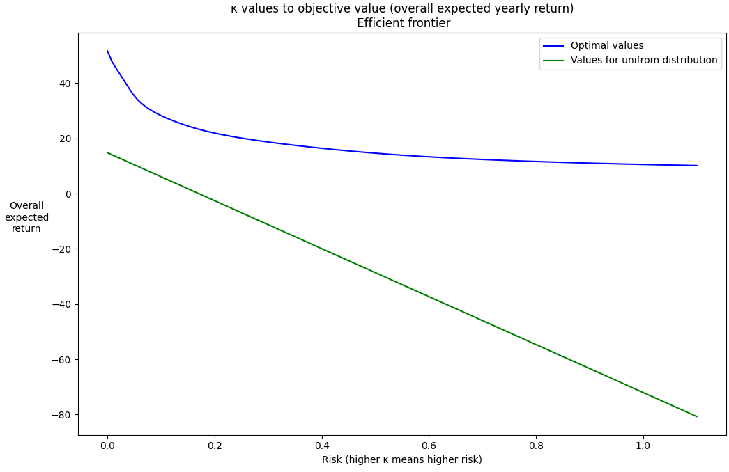
The efficient frontier - intuition

Slide 22
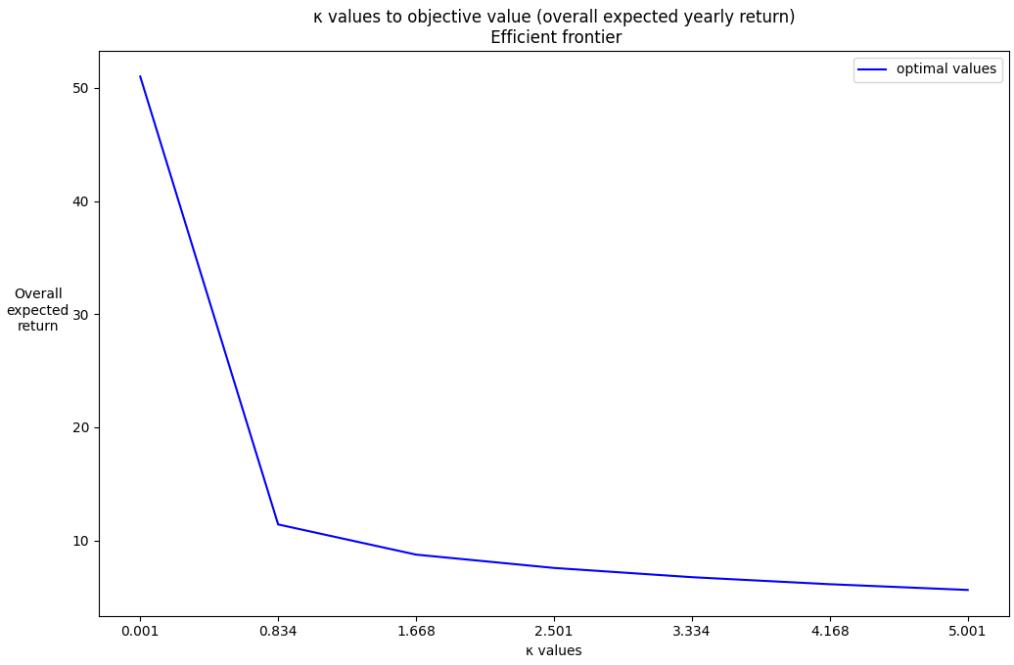
The efficient frontier - intuition

Slide 23
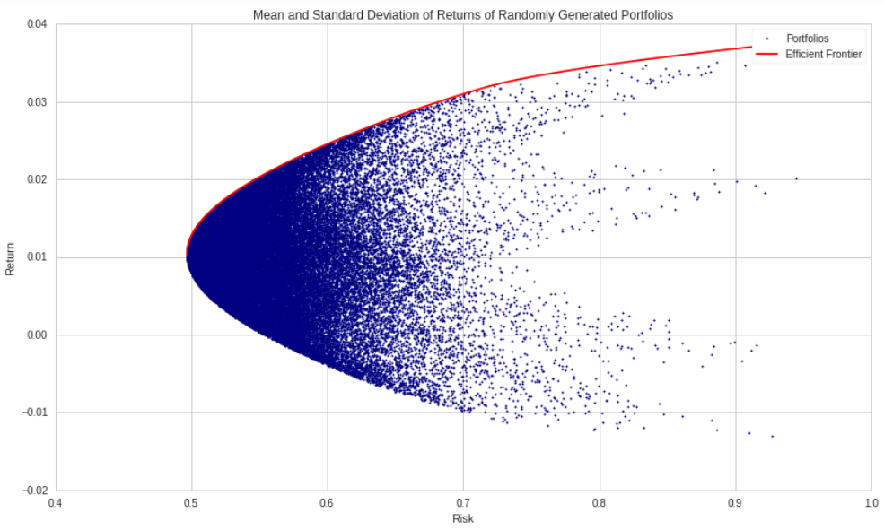
The efficient frontier - intuition
The Markowitz bullet
Source: http://alphapowertrading.com/quantopian/CAPM_Revisited_01.html

Slide 24
The Markowitz bullet - intuition
The Markowitz bullet
Source: http://alphapowertrading.com/quantopian/CAPM_Revisited_01.html

Slide 25
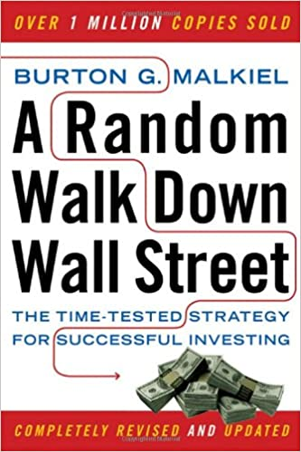

Final note – real life
Recommended reading:
https://www.hasolidit.com/
Notes:
Source:
https://www.hasolidit.com/%D7%94%D7%A9%D7%95%D7%A7-%D7%99%D7%A2%D7%99%D7%9C-%D7%99%D7%95%D7%AA%D7%A8-%D7%9E%D7%9E%D7%A0%D7%99-%D7%9E%D7%9B%D7%9D-%D7%95%D7%9E%D7%9E%D7%A9%D7%A7%D7%99%D7%A2%D7%99-%D7%94%D7%A2%D7%A8%D7%9A

Slide 26

Notes:
Source:
https://www.hasolidit.com/%D7%94%D7%A9%D7%95%D7%A7-%D7%99%D7%A2%D7%99%D7%9C-%D7%99%D7%95%D7%AA%D7%A8-%D7%9E%D7%9E%D7%A0%D7%99-%D7%9E%D7%9B%D7%9D-%D7%95%D7%9E%D7%9E%D7%A9%D7%A7%D7%99%D7%A2%D7%99-%D7%94%D7%A2%D7%A8%D7%9A

